Slide 1
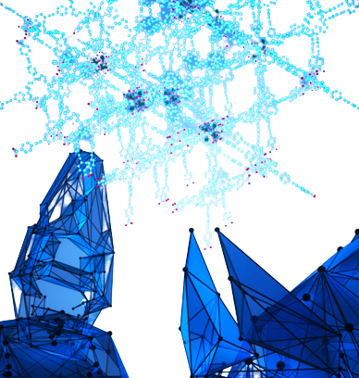
MTN-316
Team Project GROUP 6

Slide 2
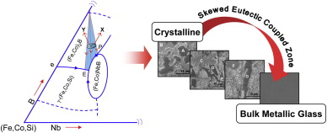
Problem Statement
Predicting full bulk metallic glass formation ability from chemical formula
Task Type of Dataset - Classification
Classification
Yes
No

Slide 3

Recording Data (Matbench) & Describe
Matbench interfaces many materials database from which we select glass formability dataset
We use this package to retrieve training & testing splits as well as making new predictions

Slide 4
Splitting
Dataset
After preparing dataset, we partition our data into train and test
Matbench have function “ .get_train_and_val () and .get_test_data () ” for splitting
Through splitting we simply train our model using training dataset and validate our data over validation dataset (test data)
Training
Testing
Training
Validation
Testing

Slide 5
Featurize Data
Presently our data is just combination of composition and target value whether glass formability present or not
To apply machine learning algorithm, we must have vector representation of our data
We use “ generate_features ” function for featurization using composition based feature vector

Slide 6


Scaling
Standard Scalar
To scale each feature to mean = 0 and variance = 1
Normalize the vector for each instance of data
Scaling is done before applying ML Algorithm so that all features contribute equally to result.
It is performed during the data pre-processing to handle highly varying magnitudes or values or units
Min-Max Scalar
Transform each feature in range between 0 to 1
This scaling preserves the shape of original distribution

Slide 7
ML Algorithms
Random Forest Classifier
Support Vector Classifier
K-Neighbors Classifier
Gradient Boosting Classifier
Ada Boost Classifier
Multi-Layer Perceptron Classifier (MLP)
Logistic Regression

Slide 8
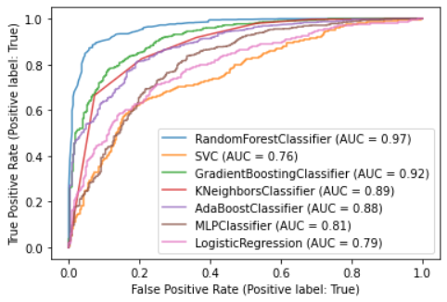
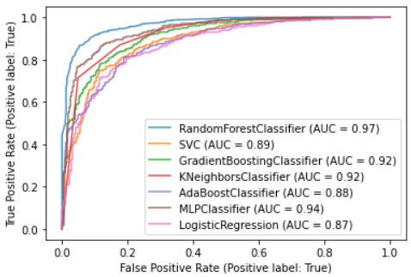
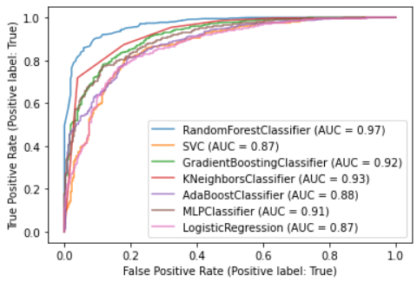
Performance
Over Test Set
Unscaled Test Set
Standard Scaled Test Set
Min-Max Scaled Test Set

Slide 9
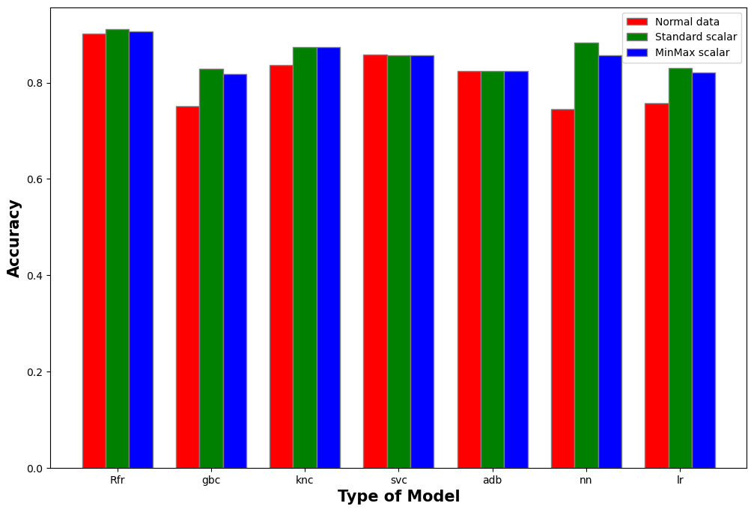
Accuracy
Plot of all dataset over different models

Slide 10
Conclusion
Standard scaling is best for the dataset which enhances the accuracy from Min-Max Scaling and Unscaled dataset. Also reduces false positive rate.
After observing all models and their accuracy score Random Forest Classifier is the best suited model for this data set

Slide 11
Thanking You !!
Team Presentation
Aditya Sen - 20118004
Ankush Sonkar - 20118011
Lokesh Jain - 20310011

